Slide 1
The Best Location For Me
comparing different factors to find your ideal destination for a workation
Katja Bucher • Phillip Lvov • Daniel Paul Quaintrell • Pracheta Rana
31.01.2023

Slide 2
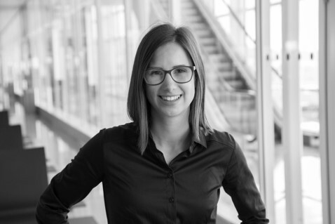
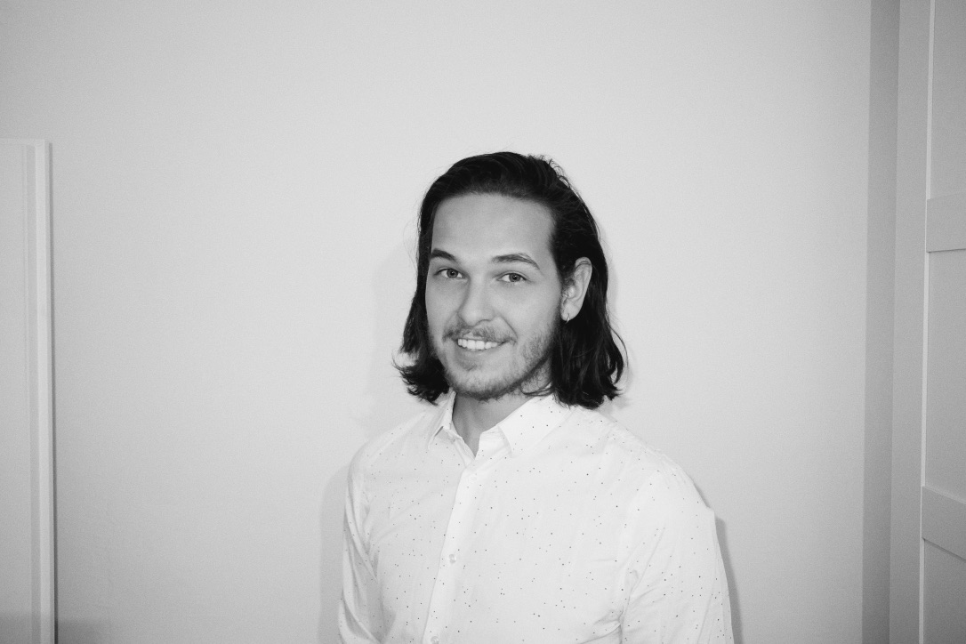
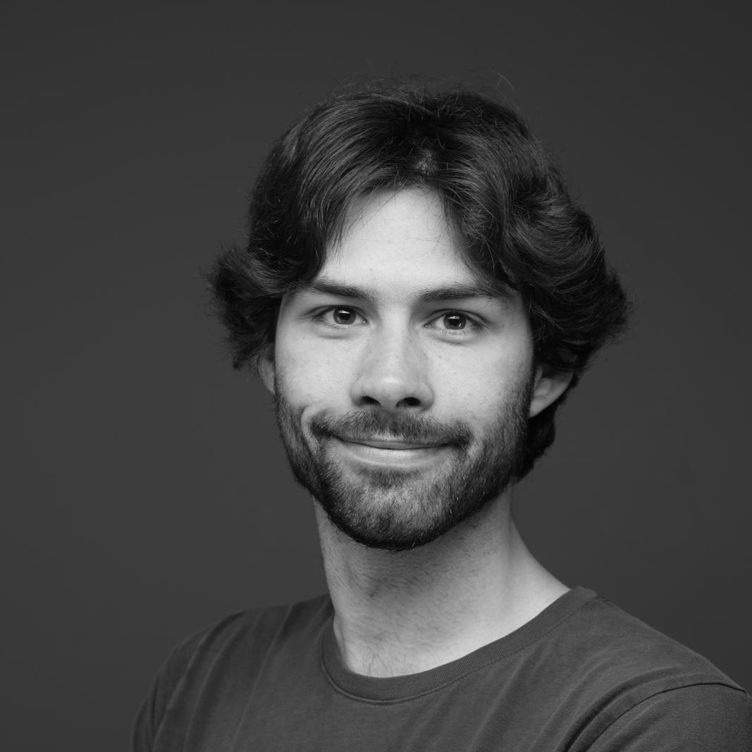
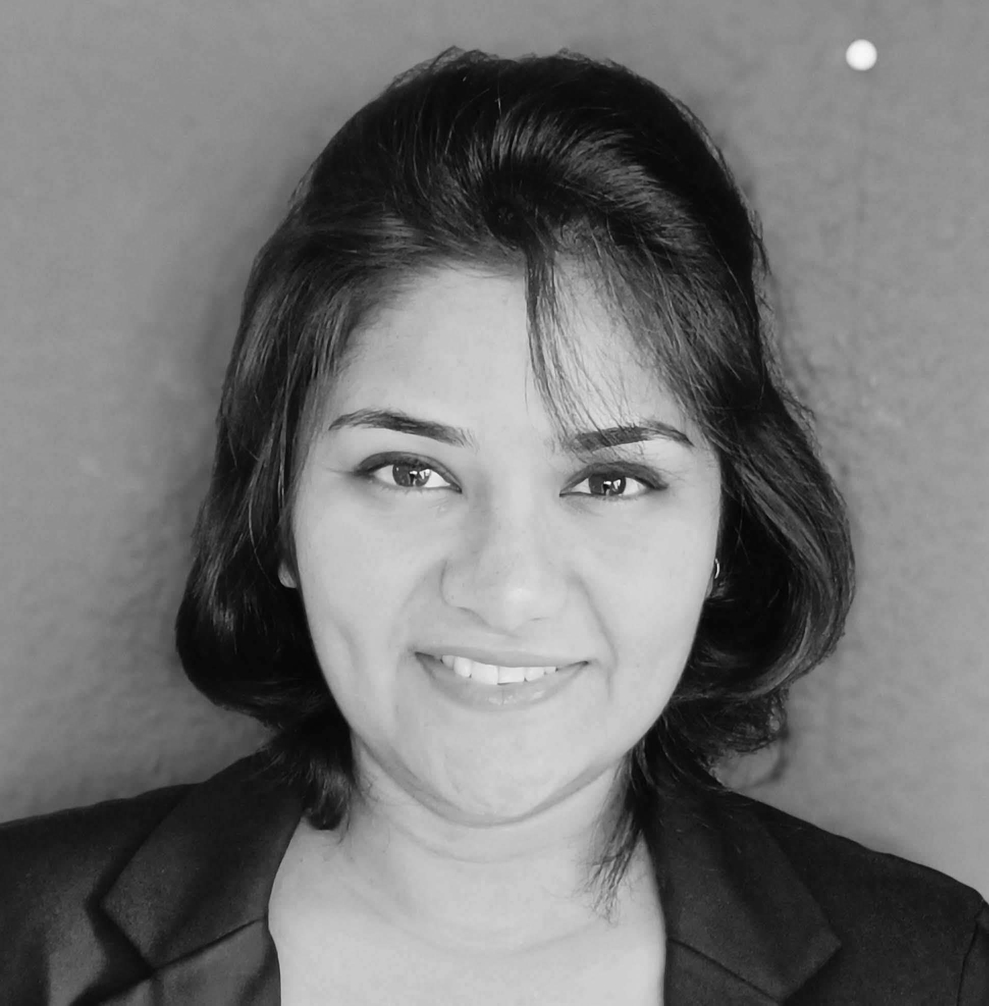
the team behind the effort
Katja Bucher
Phillip Lvov
Daniel Paul Quaintrell
Pracheta Rana
B.A. Finance, Accounting, HR
Former Investment Manager
B.A. Sales-MGMT & Business Administration
Former Sales Controller and Sales Planner
B.A. Philosophy & Linguistics
Part-Time Writer
and Hobby Astronomer
M.Sc. in Evolutionary Biology and Biodiversity
Former Biology Researcher
Notes:
Introduction: what I’ve done in the past what I’m looking for in the future

Slide 3
table of contents
CONCEPTUALIZATION | the issue, mental process and our solution
ANALYZATION | our process on getting to know our target group and data
REALIZATION | what have we done and how does our product work?
ILLUSTRATION | live demo
CONTINUATION | taking it to the next level!

Slide 4
imagine..
you are an employee and are allowed to work 100% remotely.
you want to travel to different countries, stay and work there or you're going to be an expat.
you want to check which locations are in your budget and suit your preferences.
how would you go about that?

Slide 5
the agony of choice…
many different sources
no comparability between locations
differing factors
unified
structured
normalized
data driven solution
CONCEPTUALIZATION | ANALYZATION | REALIZATION | ILLUSTRATION | CONTINUATION

Slide 6

walking in our customers shoes
are the top 3 factors for our interactive tableau dashboard
usability
easy to understand
significant results
CONCEPTUALIZATION | ANALYZATION | REALIZATION | ILLUSTRATION | CONTINUATION

Slide 7
iterative processes helped us with
our data, target group and product!
1. understand the data/customer
5. communicate via data visualisation & prototypes
05
01
04
4. proof of concept/ challenge hypothesis
2. define hypothetical solution
02
03
3. get data
CONCEPTUALIZATION | ANALYZATION | REALIZATION | ILLUSTRATION | CONTINUATION

Slide 8
heterogenic data landscapes
numbeo:
crime index
kaggle: cost of living &
internet speed
meteostat:
weather data
The Best Location For Me
CONCEPTUALIZATION | ANALYZATION | REALIZATION | ILLUSTRATION | CONTINUATION

Slide 9






user centricity sped up our prototyping process
The Best Location For Me
CONCEPTUALIZATION | ANALYZATION | REALIZATION | ILLUSTRATION | CONTINUATION
Notes:
We asked ourselves: How do you even build such a tool and how do we need users to interact with it?

Slide 10
cleaning, joining, changing
- classic data analyst work
Data Sets | rows | columns | rows after cleaning | columns after cleaning | city/country | Year of reference
1. Global cost of living data set | 4898 | 58 | 1426 | 12 | city | 2022
2. Internet speed | 177 | 3 | 42 | 3 | country | 2022
3. Crime rate | 170 | 5 | 42 | 2 | country | 2022
4. WeatherAPI | // | // | 1426 | 4 | city | 2022
In total: | // | /// | 1426 | 21
initial investigations of data and its cleaning
prioritizing the data
EDA
fine tuning
CONCEPTUALIZATION | ANALYZATION | REALIZATION | ILLUSTRATION | CONTINUATION

Slide 11
how does our tool actually work?
user sets parameters
tool scans database according to user’s input
1
tool graphically shows fitting locations
2
user can change input after receiving suggestions
3
user can export and use results
4
CONCEPTUALIZATION | ANALYZATION | REALIZATION | ILLUSTRATION | CONTINUATION
5

Slide 12

take Julia for instance..
but doesn’t know where to go!
Julia is 28 years old
Julia wants to do a workation with a friend
Julia is single and doesn’t have children
she has a budget of roughly 500 € to spend
she’d like to travel south, preferably in spring and warm weather to escape the cold in Germany..
CONCEPTUALIZATION | ANALYZATION | REALIZATION | ILLUSTRATION | CONTINUATION

Slide 13
CONCEPTUALIZATION | ANALYZATION | REALIZATION | ILLUSTRATION | CONTINUATION

Slide 14



taking our tool to the next level
global comparison
accommodation data
mobile
application
CONCEPTUALIZATION | ANALYZATION | REALIZATION | ILLUSTRATION | CONTINUATION

Slide 15











the team says thank you!
Katja Bucher
Phillip Lvov
Daniel Paul Quaintrell
Pracheta Rana
Email
+49 157 378 22119
LinkedIn
GitHub
Email
+49 151 236 11111
LinkedIn
GitHub
Email
+49 162 727 3311
LinkedIn
GitHub
Email
Phone
LinkedIn
GitHub
Notes:
Introduction: what I’ve done in the past what I’m looking for in the future

